Slide 1
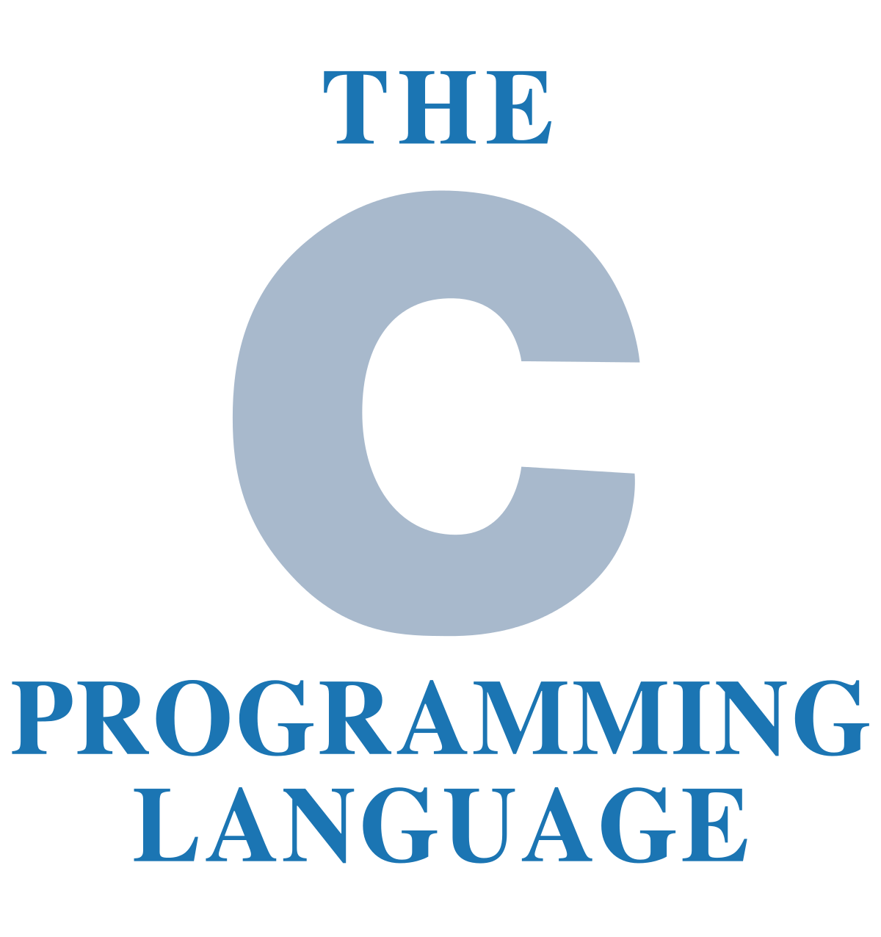
MODULE 2 - FUNDAMENTALS OF C
I Year CSE B

Slide 2
MODULE 2 - FUNDAMENTALS OF C (6L+6P)
Evolution of C -Why C language - Applications of C language - Data Types in C – Operators and Expressions – Input and Output statements in C – Decision Statements – Loop Control Statements.
Practical Component :
(i) Program to illustrate arithmetic and logical operators
(ii) Program to read and print data of different types
(iii) Program to calculate area and volume of various geometrical shapes
(iv) Program to compute biggest of three numbers
(v) Program to print multiplication table
(vi) Program to convert days to years, months and days
(vii) Program to find sum of the digits of an integer.

Slide 3
2.0 Introduction
Program:- A Set of instructions which carried out by processor for some Specific input, generates specific output.
Programming language:- A specific manner of writing a program with some Predefined rules, symbols & their use as a part of language.
i.e. Pascal, C, C++, VC++, JAVA, VB.

Slide 4
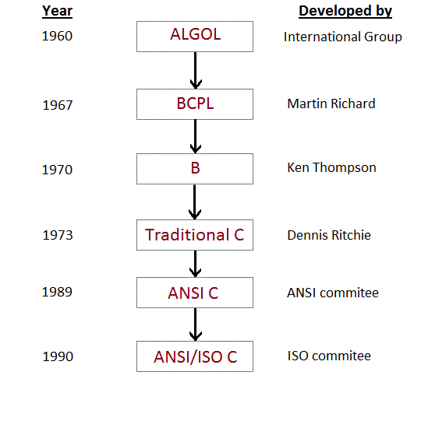
2.1 Evolution of C

Slide 5
2.2 Why C language
It is a robust language.
Highly Portable. (related to OS)
Well suited for structured programming.
Ability to extend itself.
Fast and Efficient programing.
Contains functions of rich library.
Latest version is C11 ( introduced in 2011)

Slide 6
2.3 Applications of C language
Basically for development of Operating Systems like Unix.
Used to develop
Text Editor,
Compiler,
Network drivers …
Used to develop the user Specific applications

Slide 7
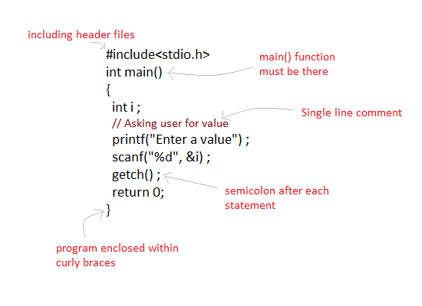
2.4 First C program

Slide 8
2.4.1 Components of C program
Pre processor ( # include) - starting part of the program
Header file ( stdio.h) in-build functions used for string handling, math functions, read and write the variables …
main () function – gives executable area
Comments - // single line or /* multiple lines */
return statement
Syntax –semicolon to end the line

Slide 9
2.4.2 Standard Headers
stdio.h – Standard Input/Output Functions: printf, open, close, read, write, scanf, etc.
conio.h - console input/output: like clrscr()
string.h - string and byte manipulation: strlen, strcpy, strcat, memcpy, memset, etc.
errno.h – defines errno used for reporting system errors
math.h – math functions: ceil, exp, floor, sqrt, etc.
time.h – time related facility: asctime, clock, time_t, etc.

Slide 10
2.4.2 Standard Headers
 | stdio.h | time.h
 | conio.h | complex.h
 | assert.h | stdalign.h
 | ctype.h | errno.h
 | cocale.h | locale.h
 | math.h | stdatomic.h
 | setjmp.h | stdnoreturn.h
 | signal.h | uchar.h
 | stdarg.h | fenv.h
 | stdlib.h | wchar.h
 | string.h | tgmath.h
 | stdbool.h | stdarg.h

Slide 11
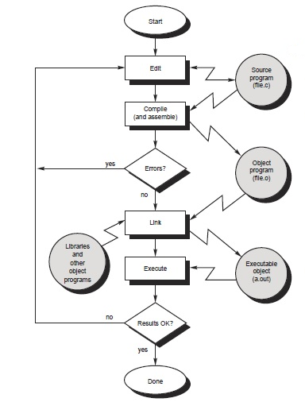
2.4.3 Execution

Slide 12
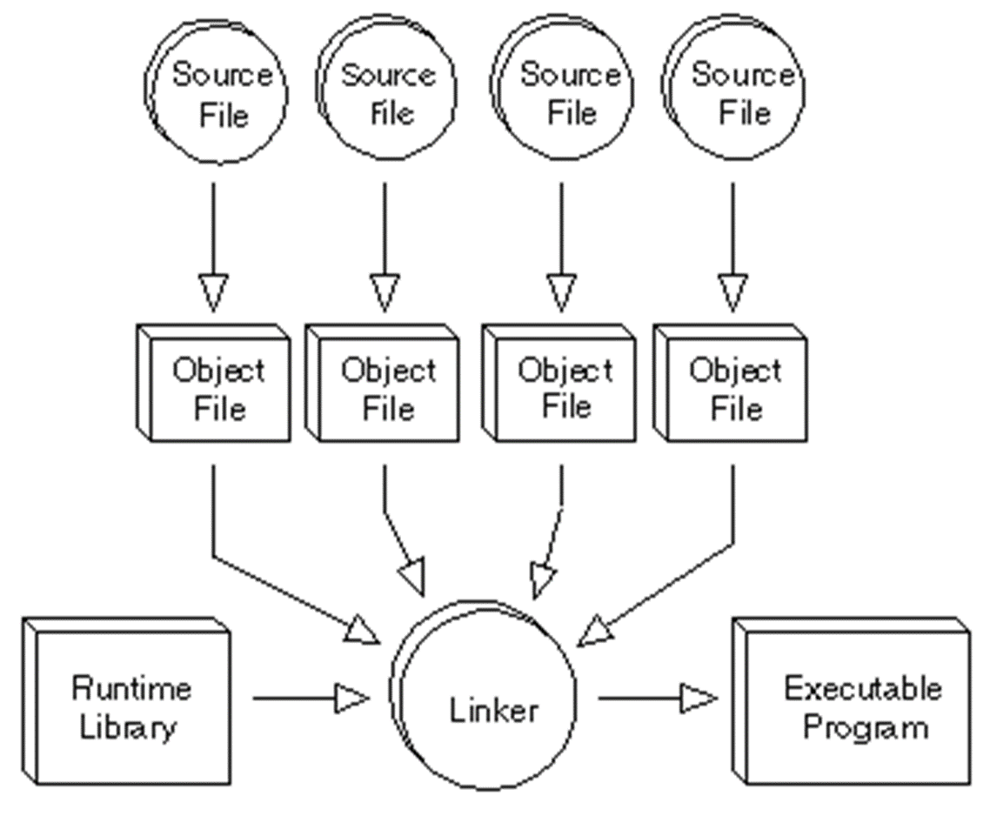
2.4.3 Linker:
A linker is a program that combines object modules to form an executable program

Slide 13
2.4.4 Identifier
An identifier is a word used by a programmer to name a variable , function, or label.
Identifiers consist of letters and digits if any order, except that the first character must be letter.
Both Upper and lowercase letters can be used.
Types :
1. System defined Identifier ( Keywords and inbuild functions)
2. User defined Identifier (Variables, constant names
and user Functions)

Slide 14
2.4.4 Keywords in C Programming
32 Keywords in C Programming
Keywords are nothing but system defined identifiers.
Keywords are reserved words of the language.
They have specific meaning in the language and cannot be used by the programmer as variable or constant names
C is case sensitive, it means these must be used as it is
auto | double | int | struct
break | else | long | switch
case | enum | register | typedef
char | extern | return | union
const | float | short | unsigned
continue | for | signed | void
default | goto | sizeof | volatile
do | if | static | while

Slide 15
2.4.6 Escape Sequences
Sometimes, it is necessary to use characters which cannot be typed or has special meaning in C programming. For example: newline(enter), tab, question mark etc. In order to use these characters, escape sequence is used.
Sequences Character
\b Backspace
\f Form feed
\n Newline
\r Return
\t Horizontal tab
\v Vertical tab
\\ Backslash
\' Single quotation mark
\" Double quotation mark
\? Question mark
\0 Null character

Slide 16
2.5 Data Types in C
Data types in C refer to an extensive system used for declaring variables or functions of different types.
The type of a variable determines how much space it occupies in storage and how the bit pattern stored is interpreted.
Types:
Basic Types or Primary Types
(a) integer (b) floating-point (c) Character
Derived types
They include (a) Pointer (b) Array (c) Structure
(d) Union (e) Function.

Slide 17
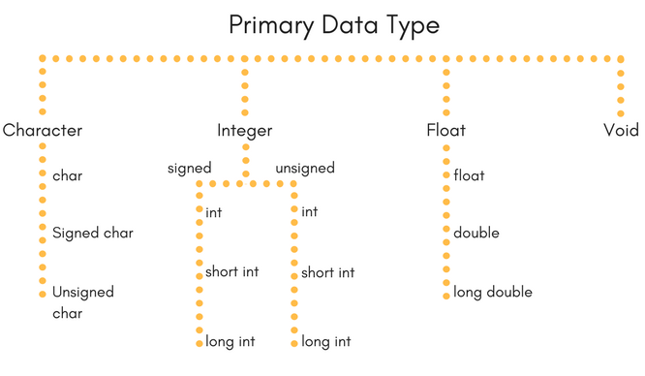
2.5 Data Types in C

Slide 18
2.5.1 Integer Types
The following table provides the details of standard integer types with their storage sizes and value ranges −
Type | Storage size | Value range
char | 1 byte | -128 to 127 or 0 to 255
unsigned char | 1 byte | 0 to 255
signed char | 1 byte | -128 to 127
int | 2 or 4 bytes | -32,768 to 32,767 or -2,147,483,648 to 2,147,483,647
unsigned int | 2 or 4 bytes | 0 to 65,535 or 0 to 4,294,967,295
short | 2 bytes | -32,768 to 32,767
unsigned short | 2 bytes | 0 to 65,535
long | 4 bytes | -2,147,483,648 to 2,147,483,647
unsigned long | 4 bytes | 0 to 4,294,967,295

Slide 19
2.5.2 Floating-Point Types
The following table provide the details of standard floating-point types with storage sizes and value ranges and their precision −
Type | Storage size | Value range | Precision
float | 4 byte | 1.2E-38 to 3.4E+38 | 6 decimal places
double | 8 byte | 2.3E-308 to 1.7E+308 | 15 decimal places
long double | 10 byte | 3.4E-4932 to 1.1E+4932 | 19 decimal places

Slide 20
2.5.3 C - Variables
A variable is nothing but a name given to a storage area that our programs can manipulate.
Each variable in C has a specific type, which determines
the size and layout of the variable's memory;
the range of values that can be stored within that memory;
the set of operations that can be applied to the variable.
The name of a variable can be composed of letters, digits, and the underscore character.
It must begin with either a letter or an underscore.
Upper and lowercase letters are distinct because C is case-sensitive.
No space is allowed between variables

Slide 21
2.5.3 C - Variables
Identifier | Variable
Identifier is the name given to a variable, function etc. | While, variable is used to name a memory location which stores data.
An identifier can be a variable, but not all indentifiers are variables. | All variable names are identifiers.

Slide 22
2.5.4 Constants
A constant is a value or an identifier whose value cannot be altered in a program. For example: 1, 2.5,
As mentioned, an identifier also can be defined as a constant. eg. const double PI = 3.14
Integer constants
A integer constant is a numeric constant (associated with number) without any fractional or exponential part. There are three types of integer constants in C programming:
decimal constant(base 10)
octal constant(base 8)
hexadecimal constant(base 16)
const type variable = value;

Slide 23
2.5.3 Constants (2)
Floating-point constants
A floating point constant is a numeric constant that has either a fractional form or an exponent form.
For example: 2.0,0.0000234,-0.22E-5
Character constants
A character constant is a constant which uses single quotation around characters.
For example: 'a', 'l', 'm', 'F'
String constants
String constants are the constants which are enclosed in a pair of double-quote marks.
For example: "good" ,"x","Earth is round\n"

Slide 24
2.5.3 Constants (3)
#include <stdio.h>
int main() {
const int LENGTH = 20;
const int WIDTH = 15;
const char NEWLINE = '\n';
int area;
area = LENGTH * WIDTH;
printf(“Value of area : %d", area);
printf("%c", NEWLINE);
return 0;
}
Value of area : 300

Slide 25
2.6 Operators and Expressions
An operator is a symbol that tells the compiler to perform specific mathematical or logical functions.
C language has rich in built-in operators and provides the following types of operators −
Arithmetic Operators
Relational Operators
Logical Operators
Bitwise Operators
Assignment Operators
Misc Operators

Slide 26
2.6.1 Arithmetic Operators
Operator | Description | Example (A=10, B=20)
+ | Adds two operands. | A + B = 30
− | Subtracts second operand from the first. | A − B = -10
* | Multiplies both operands. | A * B = 200
/ | Divides numerator by de-numerator. | B / A = 2
% | Modulus Operator and remainder of after an integer division. | B % A = 0
++ | Increment operator increases the integer value by one. | A++ = 11
-- | Decrement operator decreases the integer value by one. | A-- = 9

Slide 27
2.6.2 Relational Operators
Operator | Description | Example (A=10, B=20)
== | Checks if the values of two operands are equal or not. If yes, then the condition becomes true. | (A == B) is not true.
!= | Checks if the values of two operands are equal or not. If the values are not equal, then the condition becomes true. | (A != B) is true.
> | Checks if the value of left operand is greater than the value of right operand. If yes, then the condition becomes true. | (A > B) is not true.
< | Checks if the value of left operand is less than the value of right operand. If yes, then the condition becomes true. | (A < B) is true.
>= | Checks if the value of left operand is greater than or equal to the value of right operand. If yes, then the condition becomes true. | (A >= B) is not true.
<= | Checks if the value of left operand is less than or equal to the value of right operand. If yes, then the condition becomes true. | (A <= B) is true.

Slide 28
2.6.3 Logical Operators
Operator | Description | Example (A=10, B=0)
&& | Called Logical AND operator. If both the operands are non-zero, then the condition becomes true. | (A && B) is false.
|| | Called Logical OR Operator. If any of the two operands is non-zero, then the condition becomes true. | (A || B) is true.
! | Called Logical NOT Operator. It is used to reverse the logical state of its operand. If a condition is true, then Logical NOT operator will make it false. | !(A && B) is true.

Slide 29
2.6.4 Bitwise Operators
Operator | Description | Example B=0011 1101 (61) A=0000 1100 (12)
& | Binary AND Operator copies a bit to the result if it exists in both operands. | (A & B) = 12, i.e., 0000 1100
| | Binary OR Operator copies a bit if it exists in either operand. | (A | B) = 61, i.e., 0011 1101
^ | Binary XOR Operator copies the bit if it is set in one operand but not both. | (A ^ B) = 49, i.e., 0011 0001
~ | Binary Ones Complement Operator is unary and has the effect of 'flipping' bits. | (~A ) = -60, i.e,. 1100 0100 in 2's complement form.
<< | Binary Left Shift Operator. The left operands value is moved left by the number of bits specified by the right operand. A=00111100 | A << 2 = 240 i.e., 1111 0000
>> | Binary Right Shift Operator. The left operands value is moved right by the number of bits specified by the right operand. | A >> 2 = 15 i.e., 0000 1111

Slide 30
2.6.5 Assignment Operators
Operator | Description | Example
= | Simple assignment operator. Assigns values from right side operands to left side operand | C = A + B will assign the value of A + B to C
+= | Add AND assignment operator. It adds the right operand to the left operand and assign the result to the left operand. | C += A is equivalent to C = C + A
-= | Subtract AND assignment operator. It subtracts the right operand from the left operand and assigns the result to the left operand. | C -= A is equivalent to C = C - A
*= | Multiply AND assignment operator. It multiplies the right operand with the left operand and assigns the result to the left operand. | C *= A is equivalent to C = C * A
/= | Divide AND assignment operator. It divides the left operand with the right operand and assigns the result to the left operand. | C /= A is equivalent to C = C / A
%= | Modulus AND assignment operator. It takes modulus using two operands and assigns the result to the left operand. | C %= A is equivalent to C = C % A
<<= | Left shift AND assignment operator. | C <<= 2 is same as C = C << 2
>>= | Right shift AND assignment operator. | C >>= 2 is same as C = C >> 2
&= | Bitwise AND assignment operator. | C &= 2 is same as C = C & 2
^= | Bitwise exclusive OR and assignment operator. | C ^= 2 is same as C = C ^ 2
|= | Bitwise inclusive OR and assignment operator. | C |= 2 is same as C = C | 2

Slide 31
2.6.6 Misc Operators
Operator | Description | Example
sizeof() | Returns the size of a variable. | sizeof(a), where a is integer, will return 4.
& | Returns the address of a variable. | &a; returns the actual address of the variable.
* | Pointer to a variable. | *a;
? : | Conditional Expression. | If Condition is true ? then value X : otherwise value Y

Slide 32
2.7 Input and Output statements in C
Input means to provide the program with some data to be used in the program.
Output means to display data on screen or write the data to a printer or a file.
C programming language provides many built-in functions to read any given input and to display data on screen when there is a need to output the result.
scanf() and printf() functions
getch() & putch () functions
gets() & puts() functions
#include<stdio.h>
void main()
{
char str[100];
printf("Enter a string");
gets( str );
puts( str );
getch();
}

Slide 33
2.7 Input and Output statements in C
Format string
The main difference between these two functions is that scanf() stops reading characters when it encounters a space, but gets() reads space as character too.
Format String | Meaning
%d | Scan or print an integer as signed decimal number
%f | Scan or print a floating point number
%c | To scan or print a character
%s | To scan or print a character string. The scanning ends at whitespace.
We can also limit the number of digits or characters that can be input or output, by adding a number with the format string specifier, like "%1d" or "%3s"

Slide 34
2.8 Control Structures
All programs written in terms of 3 control structures
Sequence structures: Built into C. Programs executed sequentially by default
Selection structures: C has three types: if, if/else, and switch
Repetition structures: C has three types: while, do/while and for
The precedence of arithmetic operators is (from highest to lowest)
%, *, /, +, –

Slide 35
2.8.1 Selection structures (decision making)
The C programming language provides a general decision-making capability in the form of a language construct known as the if statement.
The general format( Syntax)of this statement is as follows:
if (condition)
{ Statements; }Description:
In these type of statements, if condition is true, then respective block of code is executed.
if ( it is not raining )
I will go swimming

Slide 36
2.8.1 Selection structures
if – else statement.
if ( expression )
program statement 1
else
program statement 2
if ( your_mark>15)
You have passed in CP
else
You have failed in CP

Slide 37
2.8.1 Selection structures
#include <stdio.h> //if – else example to find the number as ODD or EVEN
int main ()
{
int number_to_test, remainder;
clrscr();
printf ("Enter your number to be tested: ");
scanf ("%i", &number_to_test);
remainder = number_to_test % 2;
if ( remainder == 0 )
printf ("The number is EVEN.\n");
else
printf ("The number is ODD.\n");
return 0;
}
O/p1
Enter your number to be tested: 15
The number is ODD.
O/p2
Enter your number to be tested: 50
The number is EVEN.

Slide 38
2.8.1 Selection structures
Nested if statement.
if ( expression1 )
program statement 1
else if( expression 2 )
program statement 2
else
program statement 3
if ( A>B)
{ if (A>C)
A is Largest
else
C is Largest
}
else if (B>C)
B is Largest
else
C is Largest

Slide 39
2.8.2 Selection structures switch statement
switch ( expression )
{
case value1:
program statement
break;
case value2:
program statement
break;
…
case value n:
program st
break;
default:
program statement
break;
}

Slide 40
2.8.2 Selection structures switch statement
#include<stdio.h>
int main( )
{
int a, b, c, choice;
clrscr();
printf("\n 1. Press 1 for addition");
printf("\n 2. Press 2 for subtraction");
printf("\n Enter your choice: ");
scanf("%d", &choice);
switch(choice)
{
case 1:
printf("Enter 2 numbers: ");
scanf("%d%d", &a, &b);
c = a + b;
printf (“\nThe result is :%d ", c);
break;
case 2:
printf("Enter 2 numbers:");
scanf("%d%d", &a, &b);
c = a - b;
printf(“\nThe result is :%d", c);
break;
default:
printf("you have passed a wrong key");
printf("\n press any key to continue");
}
getch();
return 0;
}
1. Press 1 for addition
2. Press 2 for subtraction
Enter your choice: 1
Enter 2 numbers: 7,12
The result is : 19

Slide 41
2.8.3 Selection structures
Difference between switch and if
if statements can evaluate float conditions. switch statements cannot evaluate float conditions.
if statement can evaluate relational operators. switch statement cannot evaluate relational operators i.e they are not allowed in switch statement.

Slide 42
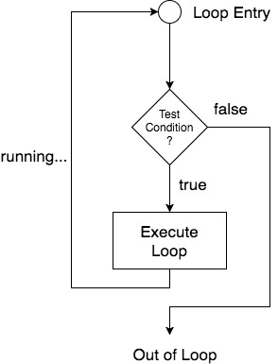
2.8.3 Repetition structures: (looping)
C has three types of loop statements: while, do/while and for

Slide 43
2.8.3 Repetition structures: (looping)
C has three types of loop statements: while, do/while and for
i) while
The general format of this statement is as follows:
while ( loop_condition )
{
program statement
loop_expression;
}
while ( today=working_day)
{ Come to college
today=today+1 }

Slide 44
2.8.3 Repetition structures: (while loop)
#include <stdio.h> // Program to print the numbers in reverse order.
int main ()
{
int number, right_digit;
printf ("Enter your number: \n");
scanf ("%i", &number);
while ( number != 0 )
{
right_digit = number % 10;
printf ("%i", right_digit);
number = number / 10;
}
return 0;
}
Enter your number: 12345
54321
Enter your number: 4500
0054

Slide 45
2.8.3 Repetition structures: (looping)
ii) do/while
The general format of this statement is as follows:
do
program statement
while ( loop_expression );
do
{ Come to college
today=today+1 }
while ( today_is_not_last_working_day)

Slide 46
2.8.3 Repetition structures: (do/while loop)
#include <stdio.h> // Program to print the numbers in reverse order.
int main ()
{
int number, right_digit;
printf ("Enter your number:\n");
scanf ("%i", &number);
do {
right_digit = number % 10;
printf ("%i", right_digit);
number = number / 10;
}
while ( number != 0 );
return 0;
}
Enter your number: 12345
54321
Enter your number: 0
0

Slide 47
2.8.3 Repetition structures: (for looping)
iii) for
The general format of this statement is as follows:
for ( init_expression; loop_condition; loop_expression )
program statement
for( today=1, not_last_working_day?, today++)
Come to college

Slide 48
2.8.3 Repetition structures: (for looping)
include<stdio.h>
void main( )
{
int x;
for(x = 1; x <= 10; x++)
{
printf("%d\n", x);
}
getch();
}
1
2
3
4
5
6
7
8
9
10

Slide 49
2.8.3 Repetition structures: (for looping)
#include<stdio.h> // Program to print half Pyramid of numbers
void main( )
{
int i, j;
for(i = 1; i < 5; i++)
{
printf("\n");
for(j = i; j > 0; j--)
{
printf("%d", j);
}
}
getch();
}
1
12
123
1234
12345

Slide 50
2.8.3 Repetition structures: (for looping)
#include<stdio.h> // Program to print table
void main( )
{
int i, j, k ;
clrscr();
printf("\n Enter the Table to be print: ");
scanf("%d", &j);
for(i= 1; i<=10; i++)
{
k=i*j;
printf("\n%d x %d = %d",i, j,k);
}
getch();
}

Slide 51
2.8.3 Repetition structures: (for looping)
#include<stdio.h> // Program to calculate sum of N numbers
void main( )
{
int i, sum=0, number;
clrscr();
printf("\n Enter the Number N: ");
scanf("%d", &number);
for(i= 1; i<= number; i++)
sum=sum+i;
printf("Sum of N (%d) numbers: %d", number, sum);
getch();
}

Slide 52
2.8.3 Repetition structures: (for looping)
#include<stdio.h> // Program to get 10 user grades and make average of it.
void main( )
{
int count, total=0, average, number;
clrscr();
for(count= 1; count<= 10; count++)
{ printf("\n Enter the Mark or Grade value: ");
scanf("%d", &number);
total=total+number;
}
average=total/10;
printf(“Average of all 10 is: %d", average);
getch();
}

Slide 53
2.8.3 Repetition structures: (for looping)
Try these
Program to find sum of the digits of an integer
Program to find factorial
Program to fine sum table

